Slide 1
Advanced Clustering

Slide 2
Hierarchical Clustering: Revisited
Creates nested clusters
Agglomerative clustering algorithms vary in terms of how the proximity of two clusters are computed
MIN (single link): susceptible to noise/outliers
MAX/GROUP AVERAGE: may not work well with non-globular clusters
CURE algorithm tries to handle both problems
Often starts with a proximity matrix
A type of graph-based algorithm

Slide 3
Recent Hierarchical Clustering Methods
Major weakness of agglomerative clustering methods
do not scale well: time complexity of at least O(n²), where n is the number of total objects
can never undo what was done previously
Integration of hierarchical with distance-based clustering
BIRCH (1996): uses CF-tree and incrementally adjusts the quality of sub-clusters
ROCK (1999): clustering categorical data by neighbor and link analysis
CHAMELEON (1999): hierarchical clustering using dynamic modeling

Slide 4
BIRCH (1996)
Birch: Balanced Iterative Reducing and Clustering using Hierarchies (Zhang, Ramakrishnan & Livny, SIGMOD’96)
Incrementally construct a CF (Clustering Feature) tree, a hierarchical data structure for multiphase clustering
Phase 1: scan DB to build an initial in-memory CF tree (a multi-level compression of the data that tries to preserve the inherent clustering structure of the data)
Phase 2: use an arbitrary clustering algorithm to cluster the leaf nodes of the CF-tree
Scales linearly: finds a good clustering with a single scan and improves the quality with a few additional scans
Weakness: handles only numeric data, and sensitive to the order of the data record.

Slide 5
Clustering Feature Vector in BIRCH
Clustering Feature: CF = (N, LS, SS)
N: Number of data points
LS: ∑^{N}_{i=1}=X_{i}
SS: ∑^{N}_{i=1}=X_{i}²
CF = (5, (16,30),(54,190))
(3,4)
(2,6)
(4,5)
(4,7)
(3,8)

Slide 6
CF-Tree in BIRCH
Clustering feature:
summary of the statistics for a given subcluster: the 0-th, 1st and 2nd moments of the subcluster from the statistical point of view.
registers crucial measurements for computing cluster and utilizes storage efficiently
A CF tree is a height-balanced tree that stores the clustering features for a hierarchical clustering
A nonleaf node in a tree has descendants or “children”
The nonleaf nodes store sums of the CFs of their children
A CF tree has two parameters
Branching factor: specify the maximum number of children.
threshold: max diameter of sub-clusters stored at the leaf nodes

Slide 7
The CF Tree Structure
Root
B = 7
L = 6
CF₁
CF₂
CF₃
CF₆
child₁
child₂
child₃
child₆
Non-leaf node
CF₁
CF₂
CF₃
CF₅
child₁
child₂
child₃
child₅
Leaf node
Leaf node
prev
CF₁
CF₂
CF₆
next
prev
CF₁
CF₂
CF₄
next

Slide 8
CURE: Another Hierarchical Approach
Uses a number of points to represent a cluster
Representative points are found by selecting a constant number of points from a cluster and then “shrinking” them toward the center of the cluster
Cluster similarity is the similarity of the closest pair of representative points from different clusters
×
×

Slide 9
CURE
Shrinking representative points toward the center helps avoid problems with noise and outliers
CURE is better able to handle clusters of arbitrary shapes and sizes

Slide 10
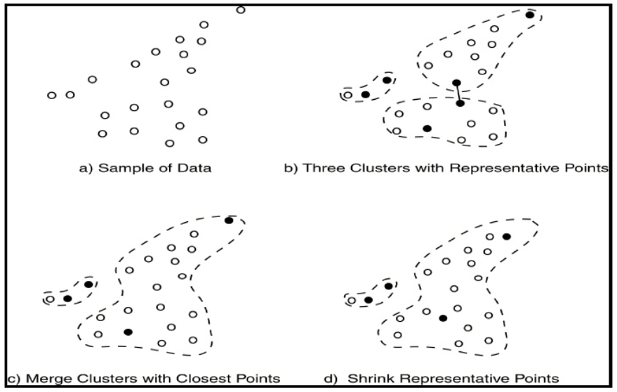
Example

Slide 11
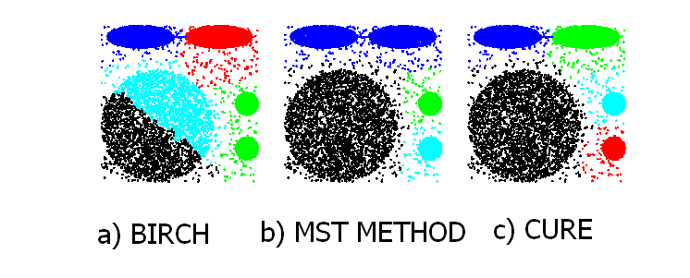
Experimental Results: CURE
Picture from CURE, Guha, Rastogi, Shim.

Slide 12
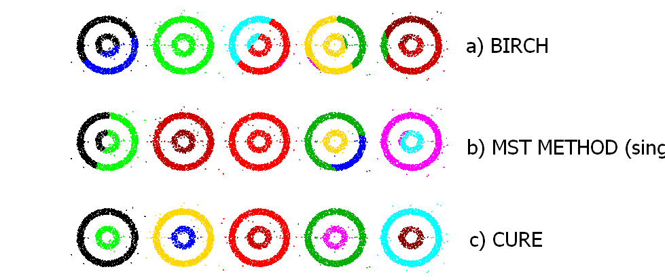
Experimental Results: CURE
(centroid)
(single link)
Picture from CURE, Guha, Rastogi, Shim.

Slide 13
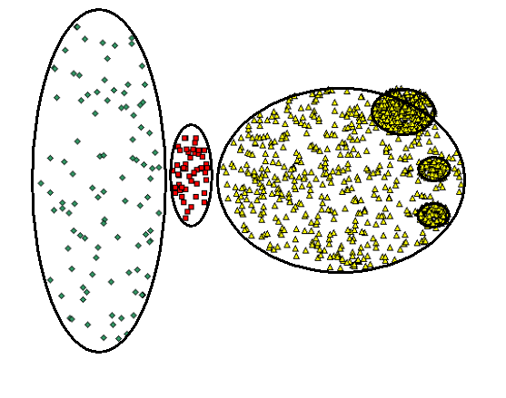
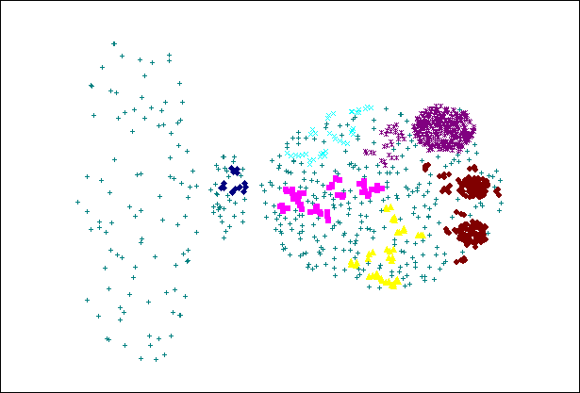
CURE Cannot Handle Differing Densities
Original Points
CURE

Slide 14
Clustering Categorical Data: The ROCK Algorithm
ROCK: RObust Clustering using linKs
S. Guha, R. Rastogi & K. Shim, ICDE’99
Major ideas
Use links to measure similarity/proximity
Not distance-based
Computational complexity:
Algorithm: sampling-based clustering
Draw random sample
Cluster with links
Label data in disk
Experiments
Congressional voting, mushroom data

Slide 15
ROCK (RObust Clustering using linKs)
Clustering algorithm for data with categorical and Boolean attributes
A pair of points is defined to be neighbors if their similarity is greater than some threshold
Uses a hierarchical clustering scheme to cluster the data.
Obtain a sample of points from the data set
Compute the link value for each set of points, i.e., transform the original similarities (computed by Jaccard coefficient) into similarities that reflect the number of shared neighbors between points
Perform an agglomerative hierarchical clustering on the data using the “number of shared neighbors” as similarity measure and maximizing “the shared neighbors” objective function
Assign the remaining points to the clusters that have been found

Slide 16
Graph-Based Clustering
Graph-Based clustering uses the proximity graph
Start with the proximity matrix
Consider each point as a node in a graph
Each edge between two nodes has a weight which is the proximity between the two points
Initially the proximity graph is fully connected
MIN (single-link) and MAX (complete-link) can be viewed as starting with this graph
In the simplest case, clusters are connected components in the graph

Slide 17
Graph-Based Clustering: Sparsification
The amount of data that needs to be processed is drastically reduced
Sparsification can eliminate more than 99% of the entries in a proximity matrix
The amount of time required to cluster the data is drastically reduce
The size of the problems that can be handled is increased

Slide 18
Graph-Based Clustering: Sparsification …
Clustering may work better
Sparsification techniques keep the connections to the most similar (nearest) neighbors of a point while breaking the connections to less similar points.
The nearest neighbors of a point tend to belong to the same class as the point itself.
This reduces the impact of noise and outliers and sharpens the distinction between clusters.
Sparsification facilitates the use of graph partitioning algorithms (or algorithms based on graph partitioning algorithms.
Chameleon and Hypergraph-based Clustering

Slide 19
Sparsification in the Clustering Process

Slide 20
What is a Spanning Tree?
A connected subgraph with no cycles that includes all vertices in the graph
G
2
2
1
3
6
1
3
6
7
3
2
5
7
2
5
4
Weight = 17
2
4
4
2
4
5
Note: Weight can represent either distance or similarity between two vertices or similarity of the two vertices

Slide 21
What is a Minimum Spanning Tree (MST)?
The spanning tree of a graph with the minimum possible sum of edge weights, if the edge weights represent distance
G
Weight = 11
1
2
3
2
6
1
3
7
3
2
5
4
3
2
5
2
4
4
5
2
4
4
2
1
3
Note: maximum possible sum of edge weights, if the edge weights represent similarity
2
5
Weight = 13
2
2
4
4
1
3
6
5
7
2
5
Weight = 17
2
4

Slide 23
Limitations of Current Merging Schemes
Existing merging schemes in hierarchical clustering algorithms are static in nature
MIN or CURE:
merge two clusters based on their closeness (or minimum distance)
GROUP-AVERAGE:
merge two clusters based on their average connectivity

Slide 25
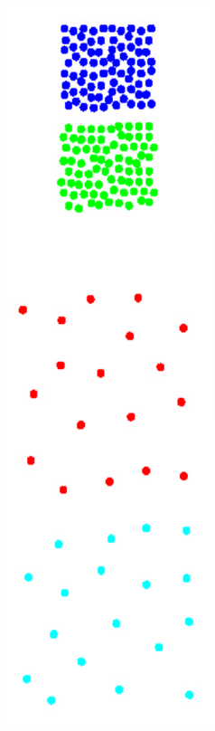
Limitations of Current Merging Schemes
(a)
(b)
Closeness schemes will merge (a) and (b)
(c)
Average connectivity schemes will merge (c) and (d)
(d)

Slide 26
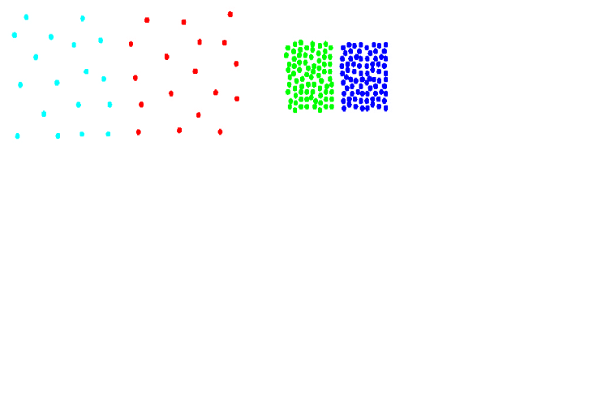
Chameleon: Clustering Using Dynamic Modeling
Adapt to the characteristics of the data set to find the natural clusters
Use a dynamic model to measure the similarity between clusters
Main property is the relative closeness and relative inter-connectivity of the cluster
Two clusters are combined if the resulting cluster shares certain properties with the constituent clusters
The merging scheme preserves self-similarity
One of the areas of application is spatial data

Slide 27
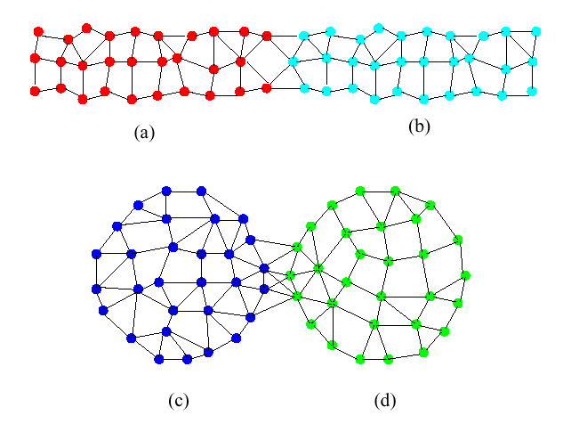
Limitations of Current Merging Schemes
(a)
(b)
(c)
(d)
Shows relative closeness
Shows inter connectedness

Slide 28
Relative Interconnectivity

Slide 29
Relative Closeness

Slide 30
Chameleon: Steps
Preprocessing Step: Represent the Data by a Graph
Given a set of points, construct the k-nearest-neighbor (k-NN) graph to capture the relationship between a point and its k nearest neighbors
Concept of neighborhood is captured dynamically (even if region is sparse)
Phase 1: Use a multilevel graph partitioning algorithm on the graph to find a large number of clusters of well-connected vertices
Each cluster should contain mostly points from one “true” cluster, i.e., is a sub-cluster of a “real” cluster

Slide 31
Chameleon: Steps …
Phase 2: Use Hierarchical Agglomerative Clustering to merge sub-clusters
Two clusters are combined if the resulting cluster shares certain properties with the constituent clusters
Two key properties used to model cluster similarity:
Relative Interconnectivity: Absolute interconnectivity of two clusters normalized by the internal connectivity of the clusters
Relative Closeness: Absolute closeness of two clusters normalized by the internal closeness of the clusters

Slide 32
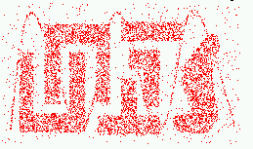
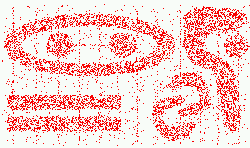
Characteristics of Spatial Data Sets
Clusters are defined as densely populated regions of the space
Clusters have arbitrary shapes, orientation, and non-uniform sizes
Difference in densities across clusters and variation in density within clusters
Existence of special artifacts (streaks) and noise
The clustering algorithm must address the above characteristics and also require minimal supervision.

Slide 33
Chameleon: Steps
Preprocessing Step: Represent the Data by a Graph
Given a set of points, construct the k-nearest-neighbor (k-NN) graph to capture the relationship between a point and its k nearest neighbors
Concept of neighborhood is captured dynamically (even if region is sparse)
Phase 1: Use a multilevel graph partitioning algorithm on the graph to find a large number of clusters of well-connected vertices
Each cluster should contain mostly points from one “true” cluster, i.e., is a sub-cluster of a “real” cluster

Slide 34
Chameleon: Steps …
Phase 2: Use Hierarchical Agglomerative Clustering to merge sub-clusters
Two clusters are combined if the resulting cluster shares certain properties with the constituent clusters
Two key properties used to model cluster similarity:
Relative Interconnectivity: Absolute interconnectivity of two clusters normalized by the internal connectivity of the clusters
Relative Closeness: Absolute closeness of two clusters normalized by the internal closeness of the clusters

Slide 35
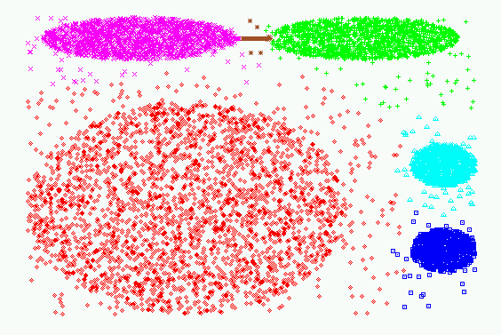
Experimental Results: CHAMELEON

Slide 36
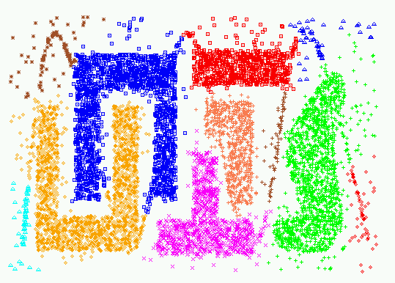
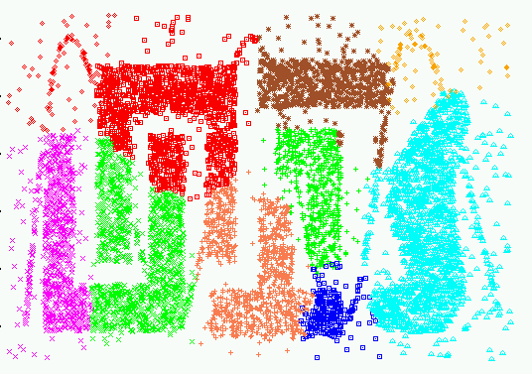
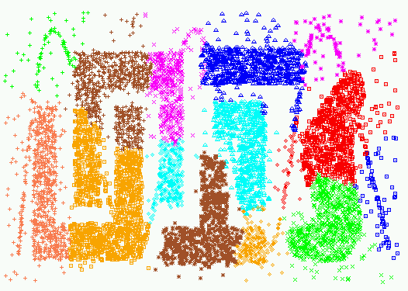
Experimental Results:
CHAMELEON
CURE (10 clusters)
CURE (15 clusters)

Slide 37
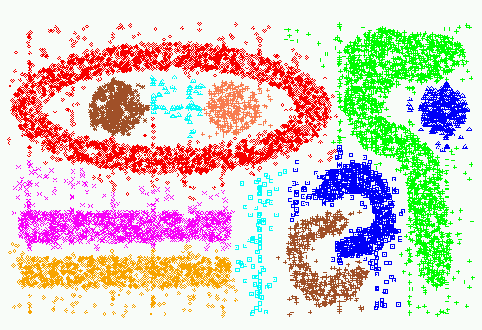
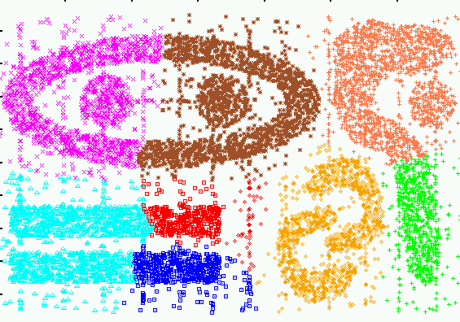
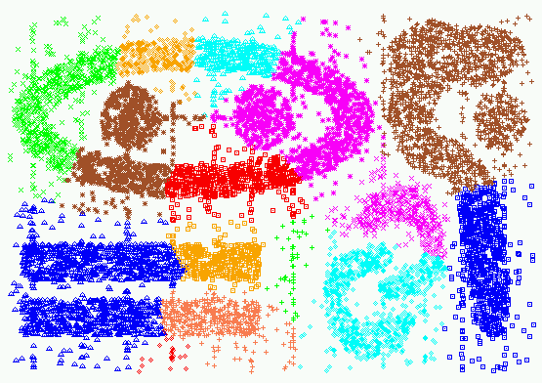
Experimental Results:
CHAMELEON
CURE (9 clusters)
CURE (15 clusters)

